Slide 1
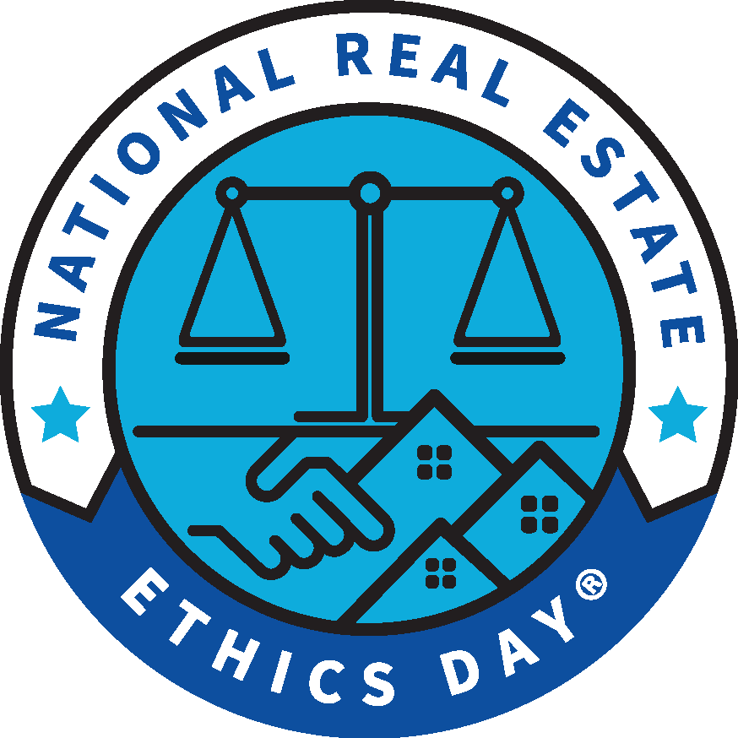
REALTORS® Code of Ethics Training CERTIFICATE OF COMPLETION
Association Name
This will certify that
Member Name
successfully completed comprehensive training on the history, structure, interpretation, and enforcement of the Code of Ethics of the National Association of REALTORS® consistent with the learning objectives and criteria established in the REALTORS® Code of Ethics Training requirement.
The Code of Ethics was adopted in 1913 to establish a high ethical standard of conduct for REALTORS® and REALTOR-ASSOCIATES®. It establishes: 1) duties to clients and customers, 2) duties to the public, and 3) duties to other REALTORS®.
Association President
Association Executive
Date

